Slide 1

Building & Mining Knowledge Graphs
(KEN4256)
Lab 5: Additional Materials
Amrapali Zaveri, Vincent Emonet

Slide 2
Bind and concat
Go to http://yasgui.org/
and select the following endpoint: http://dbpedia.org/sparql
Bind define a new variable, concat concatenate strings
Generate URI out of countries ISO code
Concatenate example
SELECT * WHERE { ?country a dbo:Country . ?country dbp:iso31661Alpha ?isoCode BIND(uri(concat("http://country.com/", ?isoCode)) AS ?isoUri) }

Slide 3
Aggregate and group by
Group solutions by variable value
Here get average GDP for all countries grouped by the currency they use
SELECT ?currency (AVG(xsd:integer(?gdp)) AS ?avgGdp) WHERE { ?country dbo:currency ?currency ; dbp:gdpPppPerCapita ?gdp . } GROUP BY ?currency order by desc(?avgGdp)

Slide 4
SPARQL endpoint and prefixes to use
Go to https://query.wikidata.org/
And keep those prefixes:
PREFIX wd: <http://www.wikidata.org/entity/> PREFIX wdt: <http://www.wikidata.org/prop/direct/> PREFIX wikibase: <http://wikiba.se/ontology#> PREFIX rdfs: <http://www.w3.org/2000/01/rdf-schema#> PREFIX bd: <http://www.bigdata.com/rdf#> PREFIX bl: <http://w3id.org/biolink/vocab/>
Notes:
Find the drugs that interacts with the protein encoded by the gene ??? and the pathway in which this interaction is involved

Slide 5
Construct
Return a graph specified by a template (build triples)
Generate type and bl:name triples for genes from Wikidata
CONSTRUCT { ?geneUri a bl:Gene ; bl:name ?geneLabel. } WHERE { ?geneUri wdt:P688 ?encodedProtein . ?encodedProtein wdt:P352 ?uniprotId . SERVICE wikibase:label { bd:serviceParam wikibase:language "en". ?encodedProtein rdfs:label ?encodesProtein . ?geneUri rdfs:label ?geneLabel . } } LIMIT 20
Triples to generate
Notes:
“Error 500: error. datatype rdf:langString requires a language tag “ on GraphDB (rdf4j).

Slide 6
Update: Insert data
Use SPARQL to insert data into your triplestore!
PREFIX bl: <http://w3id.org/biolink/vocab/> INSERT DATA { GRAPH <http://graph> { <http://whatever> bl:name "whatever" . } }
Insert this exact triple
Notes:
“Error 500: error. datatype rdf:langString requires a language tag “ on GraphDB (rdf4j).

Slide 7
Update: Delete data
To delete particular statements
Here we delete the bl:name statements for the genes we just created
PREFIX bl: <http://w3id.org/biolink/vocab/> DELETE DATA { GRAPH <http://graph> { <http://whatever> bl:name "whatever" . } }
Delete this exact triple
Notes:
“Error 500: error. datatype rdf:langString requires a language tag “ on GraphDB (rdf4j).

Slide 8
Update: Insert
Same as construct but directly insert triples into your triplestore
INSERT { GRAPH <http://graph> { ?geneUri a bl:Gene ; bl:name ?geneLabel. } } WHERE { SERVICE <https://query.wikidata.org/sparql> { SELECT * WHERE { ?geneUri wdt:P688 ?encodedProtein . ?encodedProtein wdt:P352 ?uniprotId . SERVICE wikibase:label { bd:serviceParam wikibase:language "en". ?encodedProtein rdfs:label ?encodesProtein . ?geneUri rdfs:label ?geneLabel . } } LIMIT 20 } }
Triples to insert in a graph
Call to a remote SPARQL endpoint to get the data to insert in our triplestore
Subquery to limit to 20
Notes:
“Error 500: error. datatype rdf:langString requires a language tag “ on GraphDB (rdf4j).

Slide 9
Update: Delete
To delete particular statements
Here we delete the bl:name statements for the genes we just created
DELETE { GRAPH <http://graph> { ?geneUri bl:name ?geneLabel. } } WHERE { ?geneUri a bl:Gene . ?geneUri bl:name ?geneLabel . }
Triple pattern to delete
Based on the data retrieved in this where
Notes:
“Error 500: error. datatype rdf:langString requires a language tag “ on GraphDB (rdf4j).

Slide 10
Inference
Infer statements from a shared vocabulary
Get chemical substances (including drugs) from http://graphdb.dumontierlab.com/sparql in the ncats-red-kg repository
PREFIX bl: <http://w3id.org/biolink/vocab/> SELECT DISTINCT * { ?chemUri a bl:ChemicalSubstance . OPTIONAL {?chemUri bl:name ?chemName . } }
The data use the following vocabulary: https://biolink.github.io/biolink-model/docs/
Notes:
“Error 500: error. datatype rdf:langString requires a language tag “ on GraphDB (rdf4j).

Slide 11
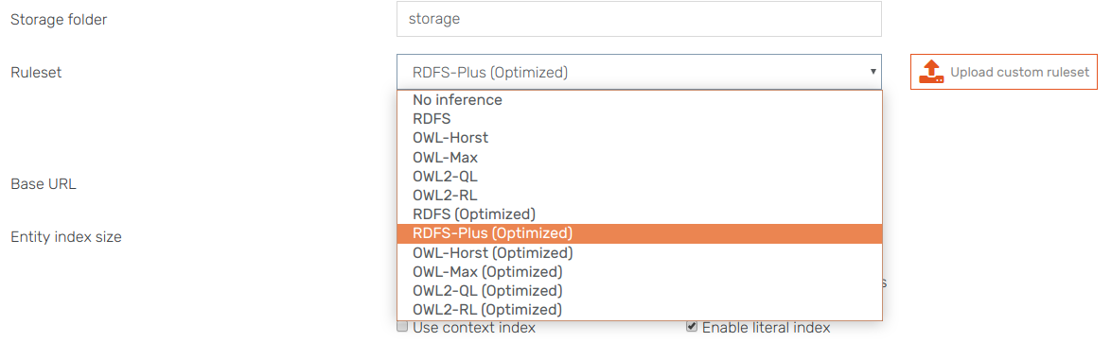
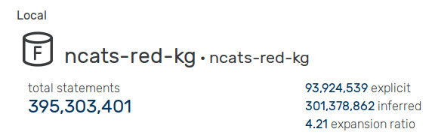
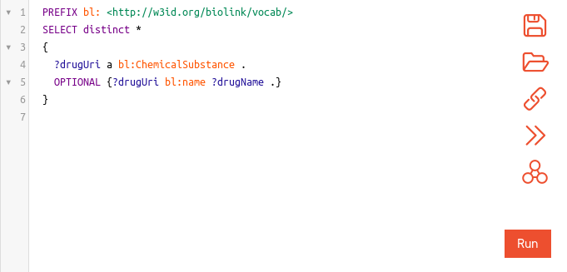
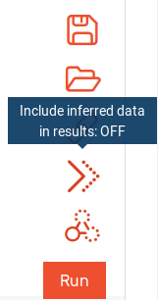

Inference
Choose inference rules when creating repository
See inferred statements
Activate/deactivate inference in results

Slide 12
Federated query
Go to http://yasgui.org/
and select the following endpoint: http://linkeddata.uriburner.com/sparql/
Find the drugs that interacts with the protein encoded by the gene DRD4 (wd:Q14866071)
Federated query enables you to query and join multiple SPARQL endpoints
Get “gene DRD4 encodes protein” information on Wikidata
Get “drug interacts with protein” on IDS GraphDB

Slide 13
Federated query
Don’t forget the prefixes!
SELECT ?gene ?encodesProtein ?affectedByDrug WHERE { SERVICE <https://query.wikidata.org/sparql> { wd:Q14866071 wdt:P688 ?encodedProtein . ?encodedProtein wdt:P352 ?uniprotId . SERVICE wikibase:label { bd:serviceParam wikibase:language "en". ?encodedProtein rdfs:label ?encodesProtein . wd:Q14866071 rdfs:label ?gene . } } SERVICE <http://graphdb.dumontierlab.com/repositories/ncats-red-kg> { ?blProtein bl:id ?uniprotId . ?association a bl:ChemicalToGeneAssociation ; bl:object ?blProtein ; bl:subject [ bl:name ?affectedByDrug ] . } }
Wikidata call to get protein encoded by gene DRD4
Resolve labels
GraphDB call to get drugs that interact with the protein encoded by gene DRD4
Notes:
Find the drugs that interacts with the protein encoded by the gene ??? and the pathway in which this interaction is involved

Slide 14
Now the same but getting drug interactions for any genes
SELECT ?gene ?encodesProtein ?affectedByDrug WHERE { SERVICE <https://query.wikidata.org/sparql> { ?geneUri wdt:P688 ?encodedProtein . ?encodedProtein wdt:P352 ?uniprotId . SERVICE wikibase:label { bd:serviceParam wikibase:language "en". ?encodedProtein rdfs:label ?encodesProtein . ?geneUri rdfs:label ?gene . } } SERVICE <http://graphdb.dumontierlab.com/repositories/ncats-red-kg> { ?blProtein bl:id ?uniprotId . ?association a bl:ChemicalToGeneAssociation ; bl:object ?blProtein ; bl:subject [ bl:name ?affectedByDrug ] . } }
Wikidata call to get genes and the protein they encode
Resolve labels
GraphDB call to get drugs that interact with the encoded protein
Notes:
Find the drugs that interacts with the protein encoded by the gene ??? and the pathway in which this interaction is involved

Slide 15
Use a subquery in the service call to avoid multiple call between services
SELECT ?gene ?encodesProtein ?affectedByDrug WHERE { SERVICE <https://query.wikidata.org/sparql> { SELECT * WHERE { ?geneUri wdt:P688 ?encodedProtein . ?encodedProtein wdt:P352 ?uniprotId . SERVICE wikibase:label { bd:serviceParam wikibase:language "en". ?encodedProtein rdfs:label ?encodesProtein . ?geneUri rdfs:label ?gene . } } LIMIT 20 } SERVICE <http://graphdb.dumontierlab.com/repositories/ncats-red-kg> { ?blProtein bl:id ?uniprotId . ?association a bl:ChemicalToGeneAssociation ; bl:object ?blProtein ; bl:subject [ bl:name ?affectedByDrug ] . } }
Wikidata call to get genes and the protein they encode
Subquery with limit
GraphDB call to get drugs that interact with the encoded protein
Notes:
Find the drugs that interacts with the protein encoded by the gene ??? and the pathway in which this interaction is involved

